Slide 1
Fourty Years of Marshing: Is the Missed Symmetry Problem now Solved?
Richard E. Marsh (1922-2017)
Ton Spek, Utrecht University, NL.
22-7-2018, ACA-Toronto

Slide 2
My Connection with Dick
My early interest in the ‘Missed Symmetry Problem’ was aroused by Dick’s 1979 paper: Richard E. Marsh & Verner Schomaker, Inorg. Chem. (1979) 18, 2331-2336, Some Incorrect Space groups in Inorg. Chem, Volume 16 (1977)
That paper inspired me, as a service crystallographer, and others to work on software to be routinely aware of this space group problem.
On the basis of that software I had a nice one-time joint ‘internet based’ collaborative paper in Acta Cryst. with corrections to the literature.

Slide 3
The Missed Symmetry Problem
Correct space group assignment to a crystal structure is not always trivial (in particular concerning the centro/non-centro choice case).
As a result, many (and still uncorrected) errors can be found in the literature and databases.
Some errors are harmful in having their impact on the presented chemistry, others can be of a more esthetic nature.
Pseudo-symmetry, disorder, poor data and twinning may confuse the issue.

Slide 4
Space Group Corrections
Space group corrections include:
Change of crystal system
Change of Laue group
Non-Centro to centrosymmetric
Missed translation symmetry
The last two cases are the more problematic ones since they may lead to structure artefacts in addition to less optimal refinement results.

Slide 5
The Problem
The problem is that the correct space group assignment is often only possible after the structure is preliminary ‘solved’ in a lower symmetry group, e,g. P1.
Authors do often not know how to manage a transformation to higher symmetry space groups. E.g. the needed origin shift (P-1) or origin choice (C2/c) problems. Education & Experience needed!
In addition, for proper evaluation of a proposed space group assignment, we will need the primary reflection data on which the study is based.
Those data are not always archived for published papers, making ‘correction reports’ based purely on coordinates tricky.

Slide 6
More Correction Papers since 1979
More erroneous structure reports, due to inexperience, started to appear in the literature, in particular in non-crystallographic journals (Inorg Chem, JACS). Often no crystalographic referees involved.
The 1979 ‘missed symmetry’ paper was the first in a series of similar papers by Dick, often in collaboration with other ‘senior’ scientists. Other authors soon picked up the same subject as well.
The procedure that was used by Dick was to look by hand for special relations in the coordinates of similar ‘independent’ atoms. Published ORTEPS are helpfull to spot problems.

Slide 7
How Large is the Problem ?
An under-bound can be gleaned from the searchable information available in the CSD
Searching the CSD for the tekst ‘REINT_OF’, that stands for ‘reinterpretation’, reports 1800 entries (89 between 2013-2017) (2018 version)
1061 of those indicated as re-interpretations are (co)authored by Dick Marsh
However, there are many more not marked yet (and corrected) in the CSD (e.g. those reported in Dick’s last Acta Cryst. (2014). C70, 834 paper).

Slide 8
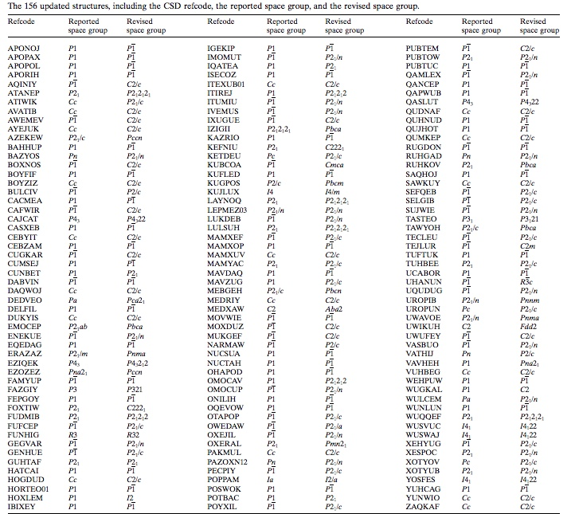
Last 2014
Acta Cryst.
C70, 834-836
paper with
156 new
corrections
In recent
Papers.
No warning
Info added
in the 2018
CSD
Will be handledi
In the 2019
Release.

Slide 9
Why Bother ?
Space group re-interpretation papers have always been controversial (and sometimes considered pedantic ..) Dick’s early rebuttal on this is already given in the Acta Cryst. (1979) B35, 1094-1099 paper:
“Some will argue that the mishap was harmless; afterall, the reported structure is essentially correct, as far as we know, except for the symmetry and the divergent lengths and angles. We can understand, but hardly agree.”

Slide 10
New Computer Based Algorithms
1982: CREDUC, Y Le Page J.Appl.Cryst.,15,255.
Determination of the Metrical Symmetry of the lattice from the number of compatible two-fold axes. E.g. 1 → monoclinic, 5 → tetragonal, 9 → cubic
Two-axis = coinciding low-index (0,1,2) direct and reciprocal lattice vectors within a tolerance.
Actual symmetry can be lower, not higher than the metrical symmetry.
The PLATON/LEPAGE tool is Modelled on CREDUC
Does the cell content support the lattice symmetry ?

Slide 11
The MISSYM Algorithm
In 1987, Y. Le Page published an extention to CREDUC called MISSYM (J.Appl.Cryst.,20,264).
MISSYM Looks for support in the actual structure (I.e. coordinate set) for the proposed metrical symmetry elements of the lattice found by the CREDUC algorithm.
Liberal tolerances are used in general to catch outliers due to refinement divergence and pseudo-symmetry cases.

Slide 12
MISSYM Implementation
Originally as part of the NRCVAX package.
That version reports additional symmetry elements but leaves their evaluation and implementation into the proper space group to the educated researcher.
In PLATON as the ADDSYM routine along with a work-up to the suggested new space group.
ADDSYM is also part of the IUCr/checkCIF tool

Slide 13
PLATON/ADDSYM Extensions
Suggests automatically a revised space group, unit cell and origin transformation.
May Generate a new ‘.res’ file for subsequent SHELXL refinement.
Allows for a percentage of non-fitting atoms in order to catch interesting pseudo-symmetry cases.
Handles sub-cells (originating from structure prediction)
Accepts input data in ‘.res’ and ‘.cif’ format.
Runs on files with multiple entries (CSD/CIF).
Display of the revised (averaged) structure.

Slide 14
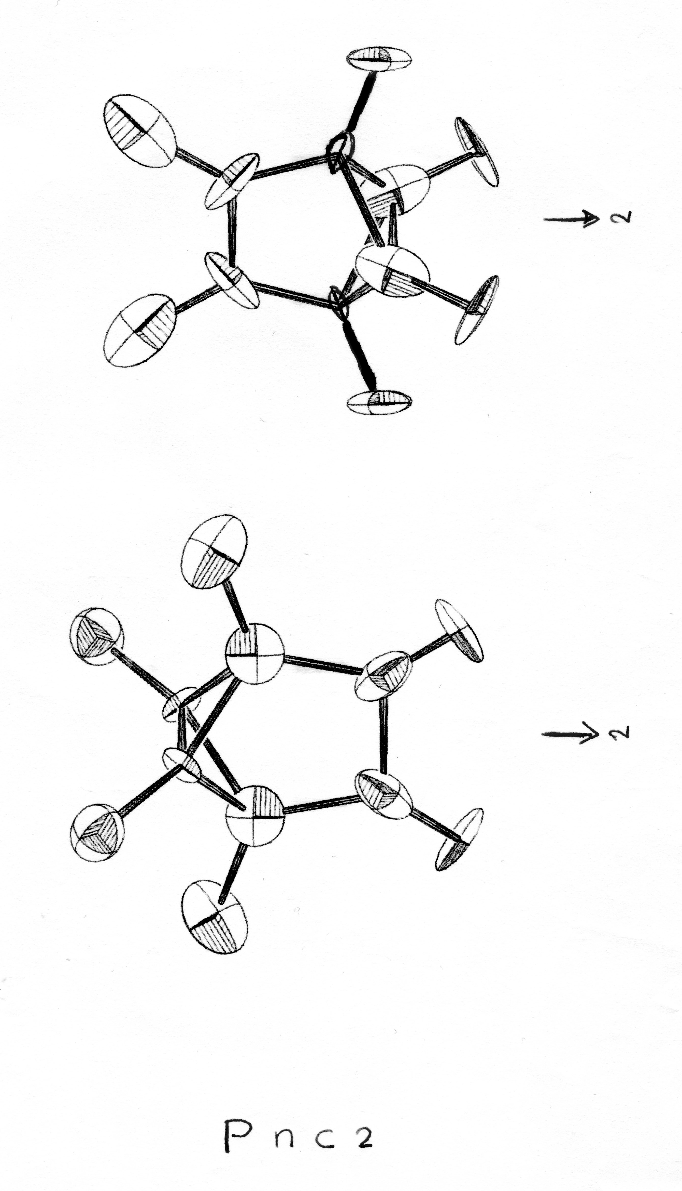
Retro Check of my own Early Publications with the ADDSYM Tool
One Hit ! in papers published in 1977, prior to the Marsh & Schomaker (1979) paper.
Cryst. Struct. Commun. (1977) 6, 259-262
(Journal was the forerunner of Acta Cryst. C)
Refined with XRAY76 in the Non-Centro Space Group Pnc2. Poor structure: R_{F} =0.08
No inversion implemented in view of
hk0, h=2n+1 outliers up to 30 sigma(I)
Re-Refined with SHELX76 in Space Group Pnca. R_{F} = 0.049, wR_{F} = 0.077

Slide 15
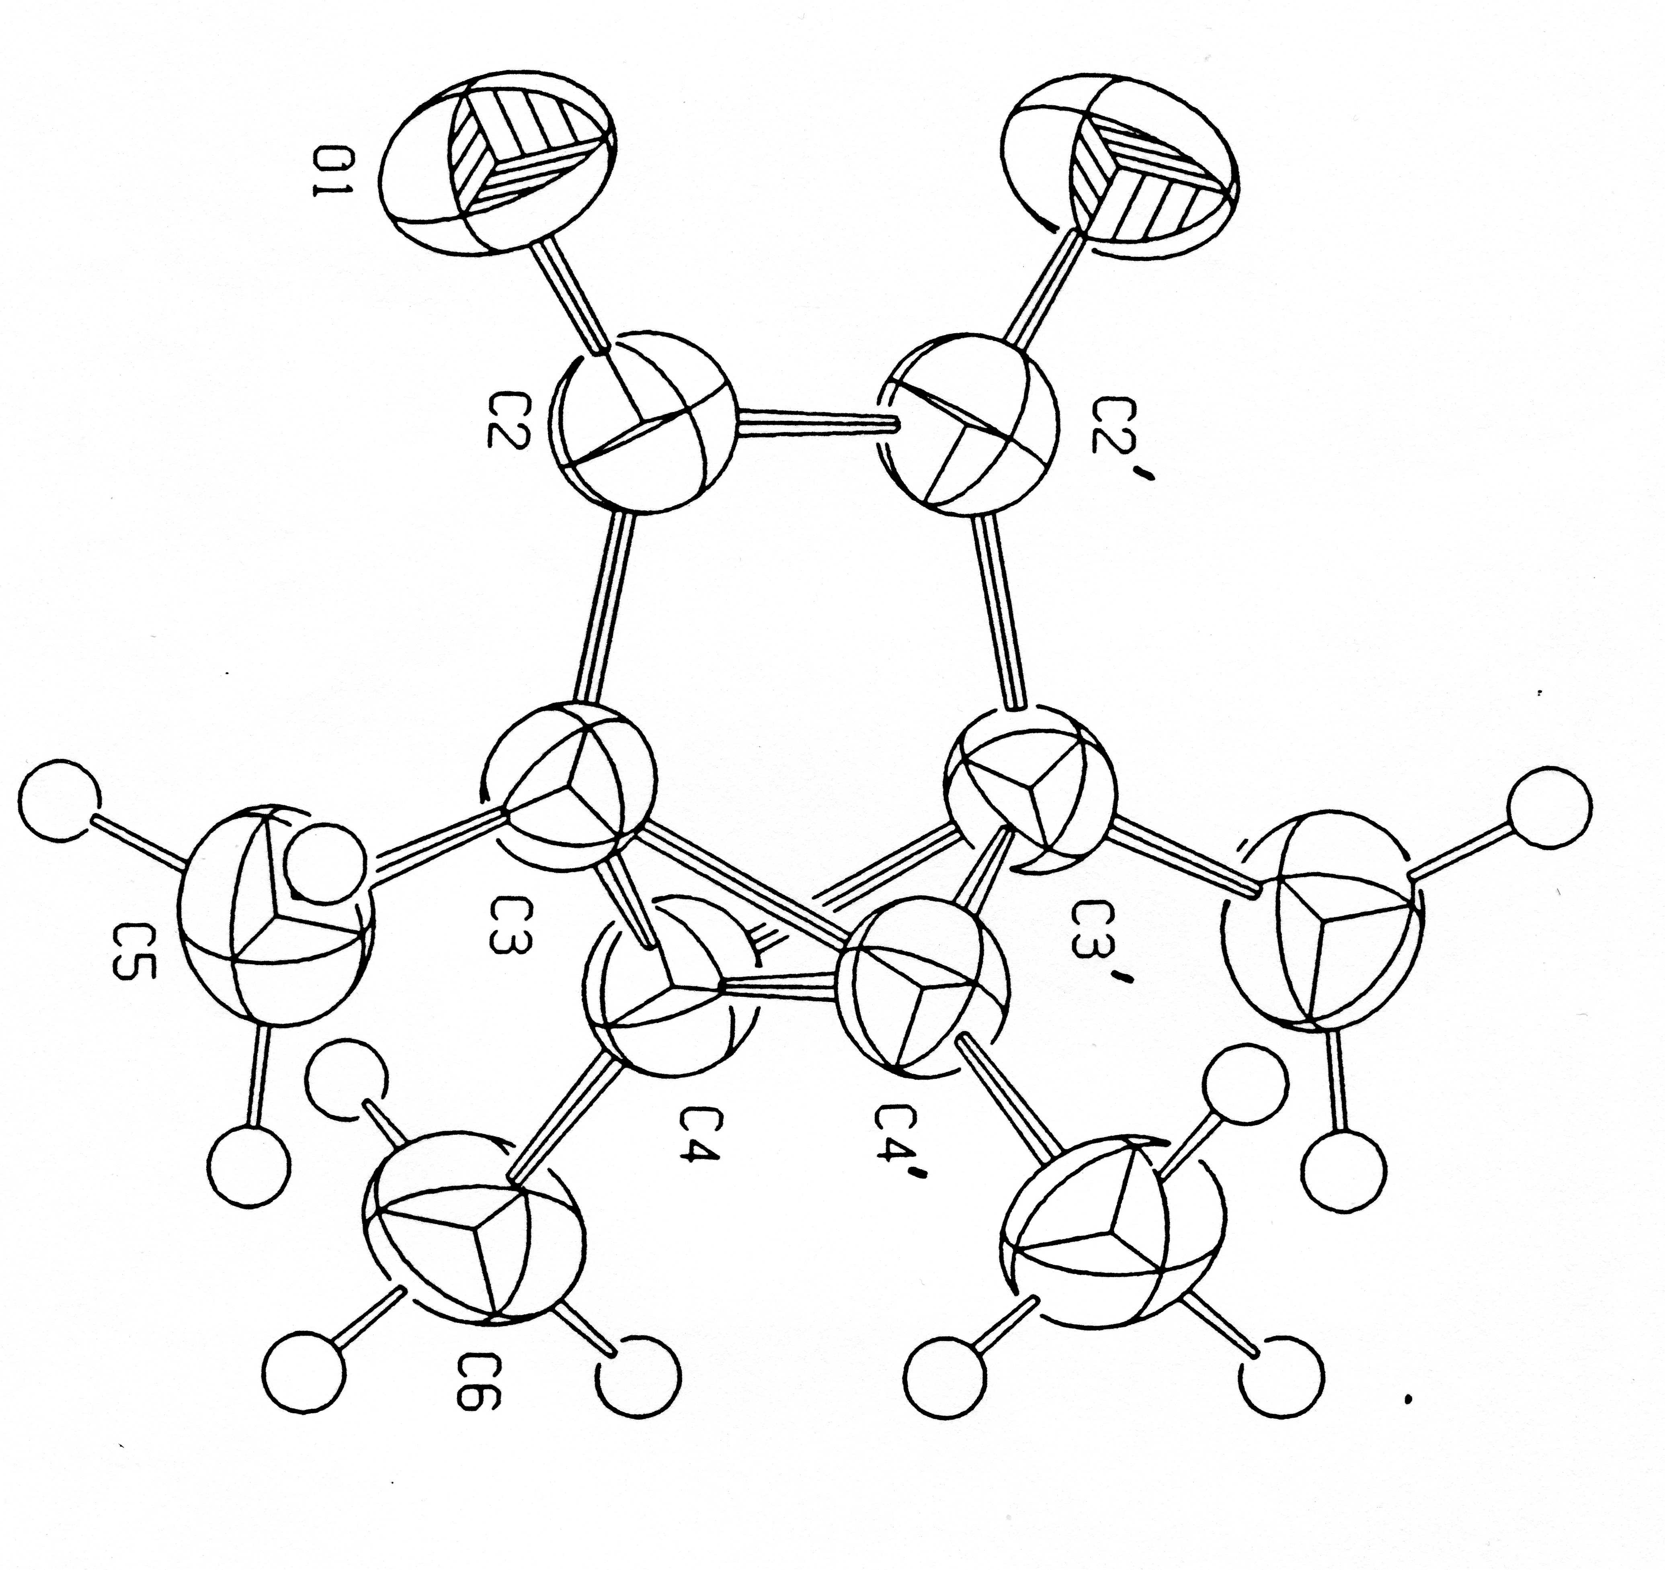
Refinement Result with the Proper Space Group Assignment
Pnc2 ==> Pnca
Acta Cryst. (1990). C46, 1357-1358
Better geometry and Displacement Parameters

Slide 16
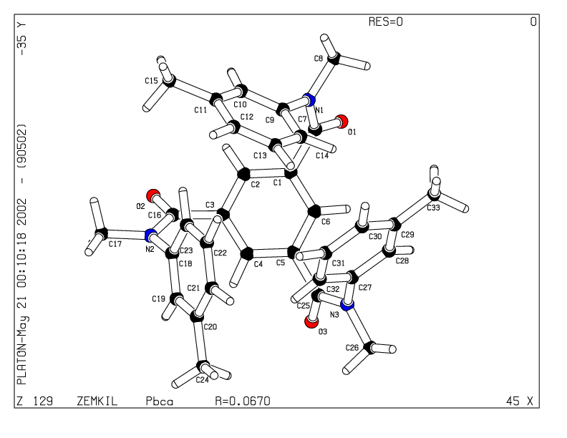
Change of Crystal System Example proposed by ADDSYM
Asymmetric Unit in Pbca

Slide 17
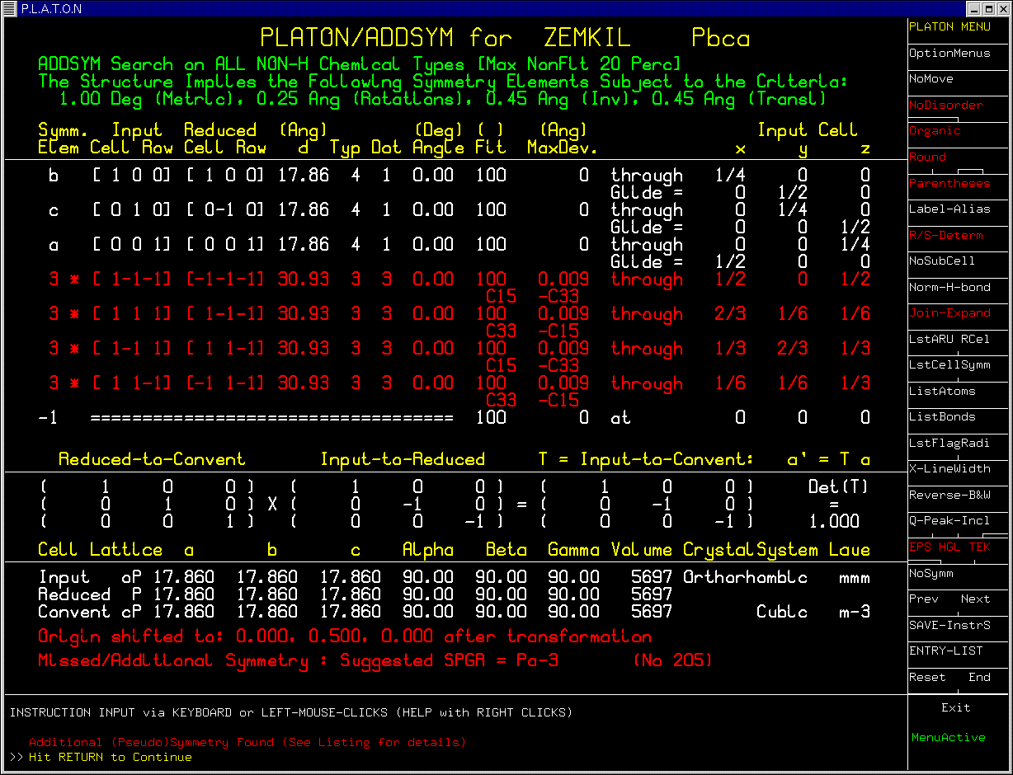

Slide 18
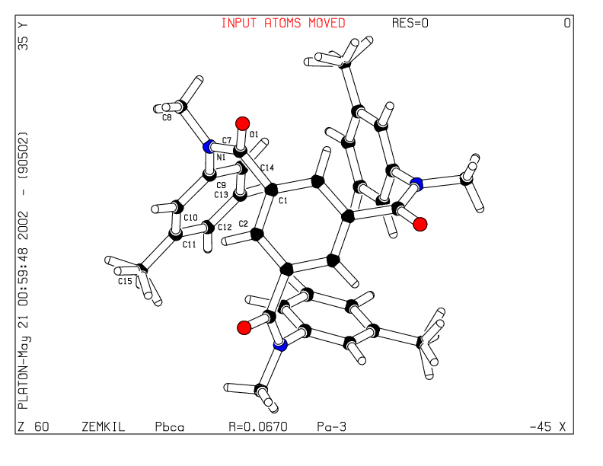
Orthorhombic Pbca ➔ Cubic Pa-3
Molecule on three fold axis

Slide 19
Early Survey’s of the Missed Symmetry Issue
A survey by Dick Marsh in 1997 of all structures published in space group Cc showed that about 10% of the assignments were wrong.
A new survey by Dick Marsh in 2004 surprisingly showed that this percentage was still around 10%.
Note: none of the additional 164 corrected assignments were from Acta Cryst. journals.
Common revisions were to C2/c, Fdd2, R-3c etc.

Slide 20
Centro or Non-centrosymmetric ?
Correct assignment is not always trivial.
Refinement of (close to) centrosymmetric structures in P1 is mathematically unstable.
Mis-assignment -> geometry artifacts.
Dick Marsh: Borderline cases are best treated as centro-symmetric (static/dynamic disorder)
Inspect Fo/Fc of weak reflection data.
In general: chiral molecules-> non-centro SpGr.

Slide 21
Interesting Story
ADDSYM can automatically analyse a CIF file containing multiple entries exported from the CSD.
In 1999, in response to the paper “P1 or P-1 or something else” I send Dick my larger automatically created “P1” list. He immediately started to work on that list and indeed found some more missed symmetry cases.
Interestingly, one of the entries (NAXQAM) that he had previously updated to Cc was ‘Marshed’ again to Fdd2. I did not realize that when I supplied my list.
I was told that he enjoyed being Marshed.

Slide 22
Joint Paper
As a follow-up, Dick asked me to send him my automatically generated list for space group corrections to structures published in C2.
This resulted in a one time long distance internet based collaboration and the paper:
“Use of software to seach for higher symmetry: space group C2”. Acta Cryst. (2001). B57, 800-805.
It was an honor and an enjoyable experience

Slide 23
ADDSYM runs for all 2013-2018 CSD Entries: Is the problem solved ?
Year #New ENTRIES ADDSYM HITS 100% FIT
2013 47233 797 (1.7%) 364 (0.77%)
2014 49546 890 (1.8) 416 (0.84)
2015 52652 860 (1.6) 390 (0.74)
2016 54333 832 (1.5) 343 (0.63)
40496 618 (1.5) 253 (0.62)
16546 258 (1.6) 93 (0.56)
‘HITS’ = Number of entries satisfying the default ADDSYM criteria for closer inspection (Not necessarily an Error)

Slide 24
ADDSYM Criteria
Default criteria are set to values to also catch large outliers (in cell dimensions or near singular refinement parameters), pseudo-symmetry, incorrectly assigned atom types etc.
All reported cases of additional symmetry should be investigated, acted upon, reported and discussed in a structure report.
Next: subset of hits for 2017 as illustration

Slide 25
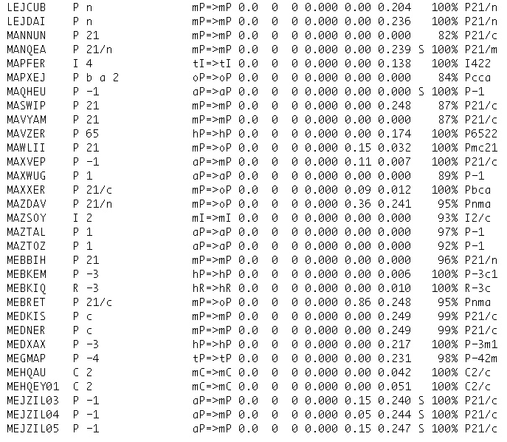
*
*

Slide 26
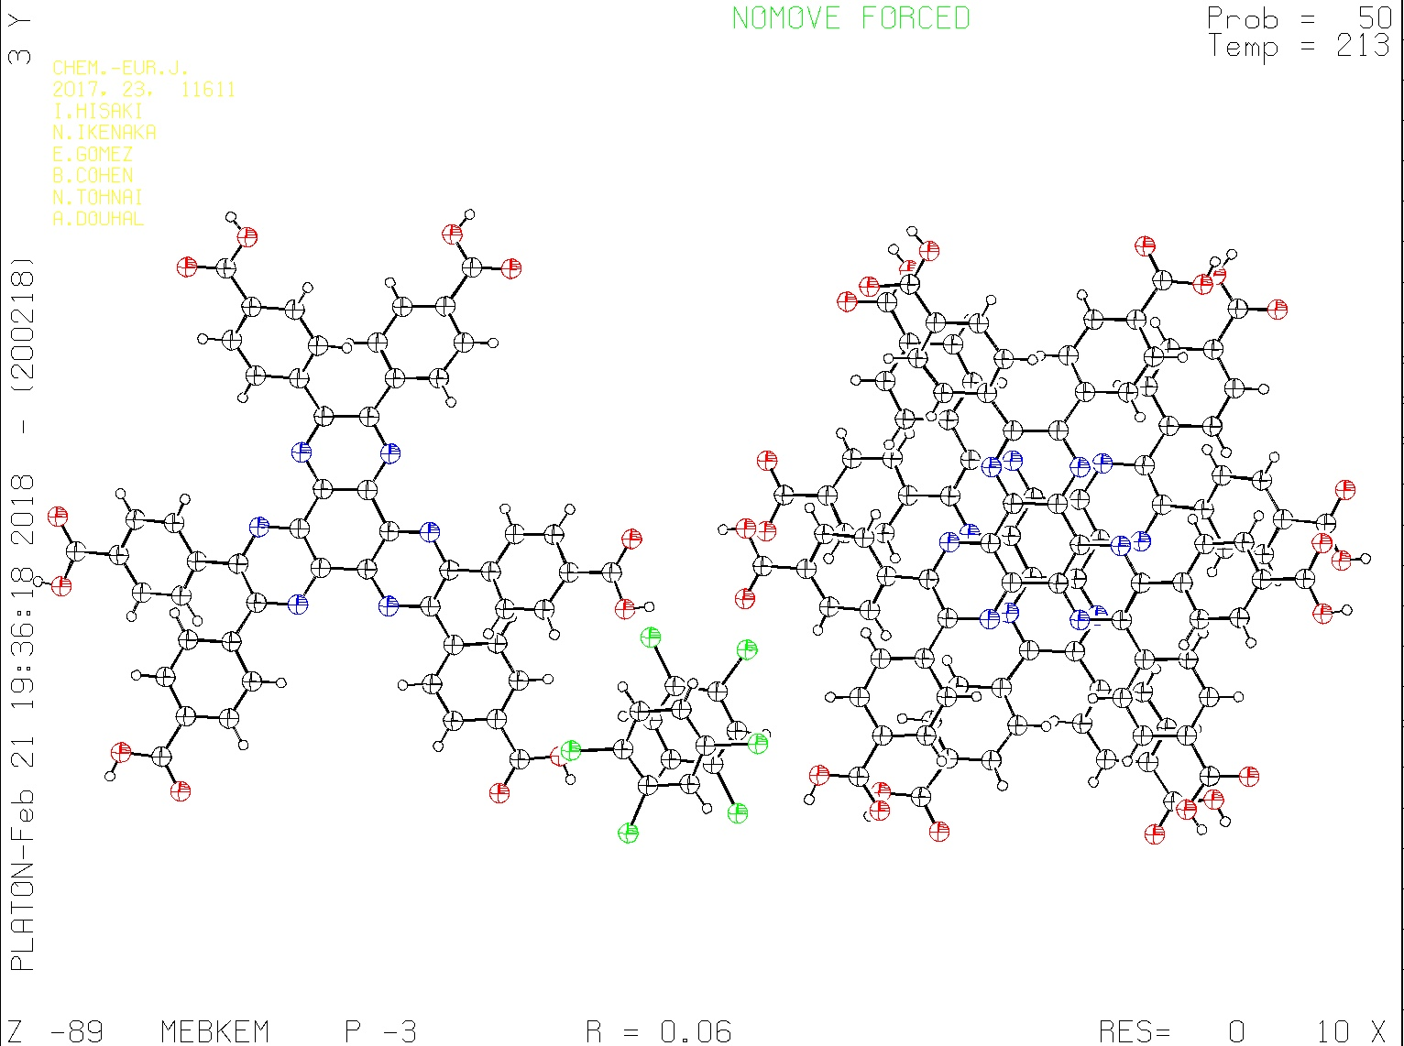
Chem. Eur.J. (2017) 23, 11611

Slide 27
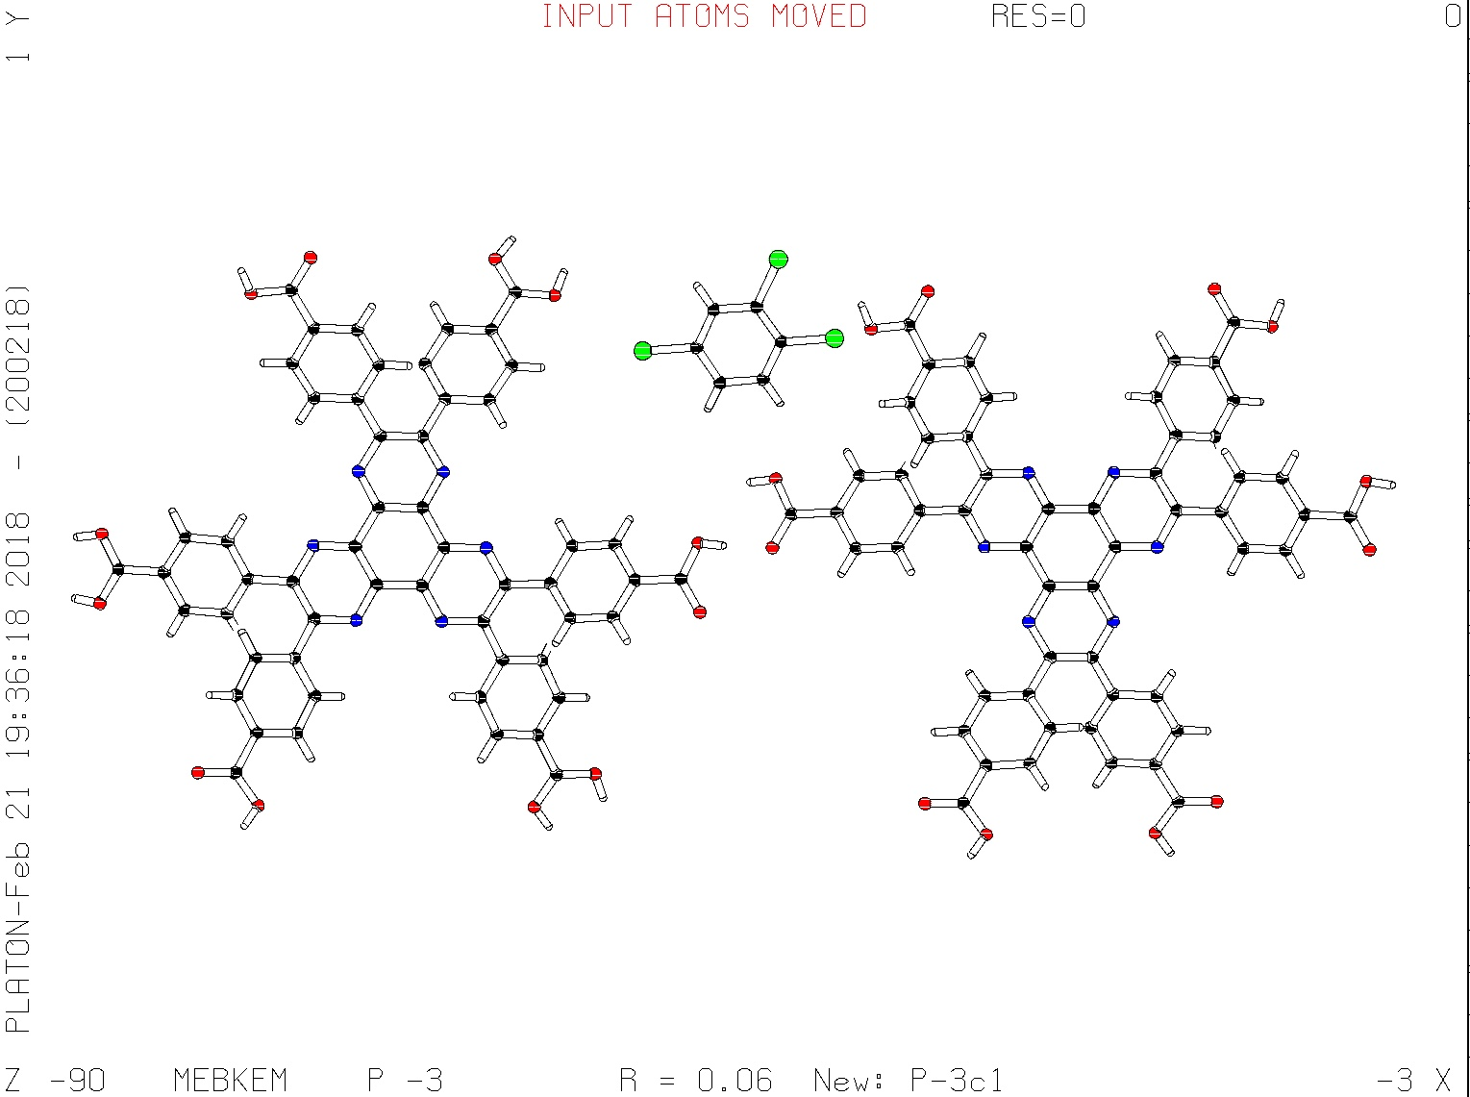
Change of LAUE class: Low to high trigonal -3 ➔ -3m1 , P-3 ➔ P-3c1

Slide 28
The Problem of too High Symmetry
In particular with point detector data, it was easy to miss weak diffraction spots, resulting in artificial disorder (i.e. averaged structures)
Pseudo-symmetry may lead to structure solutions in too high symmetry groups and artificial disorder.
Twinning may lead to similar issues
A pseudo-symmetry case next:

Slide 29
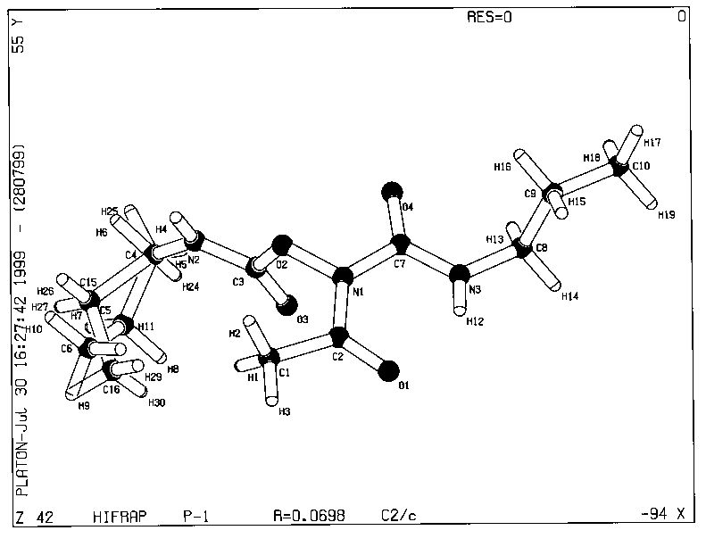
Pseudo-symmetry (less than 100% atom fit
Disorder in C2/c
Ordered in P-1

Slide 30
Comments
Hydrogen atoms and disordered atoms are not included in the ADDSYM analysis.
Pseudo-symmetry can be both problematic and/or interesting (Inorganic Structures)
Missed symmetry claims should always be supported with the primary reflection data.
In the past, those data were deposited (and sometimes retyped in support of Dick’s early symmetry corrections).
Currently embedded unmerged reflection data in SHELXL cif’s should not be deleted

Slide 31
40 Years of Marshing
Obvious Question:
Is the Missed Symmetry Issue now Solved after 40 years ?
Answer:
-Yes: For Publications in the IUCr Journals.
- No: For Publications in Chemical Journals.
It is amazing that, given the availability of tools like IUCr/checkCIF, the issue is still often ignored by authors, editors and referees.

Slide 32
Thanks Dick for Keeping our Science to Standards and You for Listening !
http://www.cryst.chem.uu.nl/spek
http://www.platonsoft.nl/spek
Email: a.l.spek@uu.nl

